Slide 1
UpGrad Hackathon

Slide 2
Problem Statement
This hackathon aims to create innovative solutions that enhance product categorization efficiency, accuracy, and scalability . Develop a multi-class text classifier that categorizes products with maximum accuracy based on the given dataset.

Slide 3
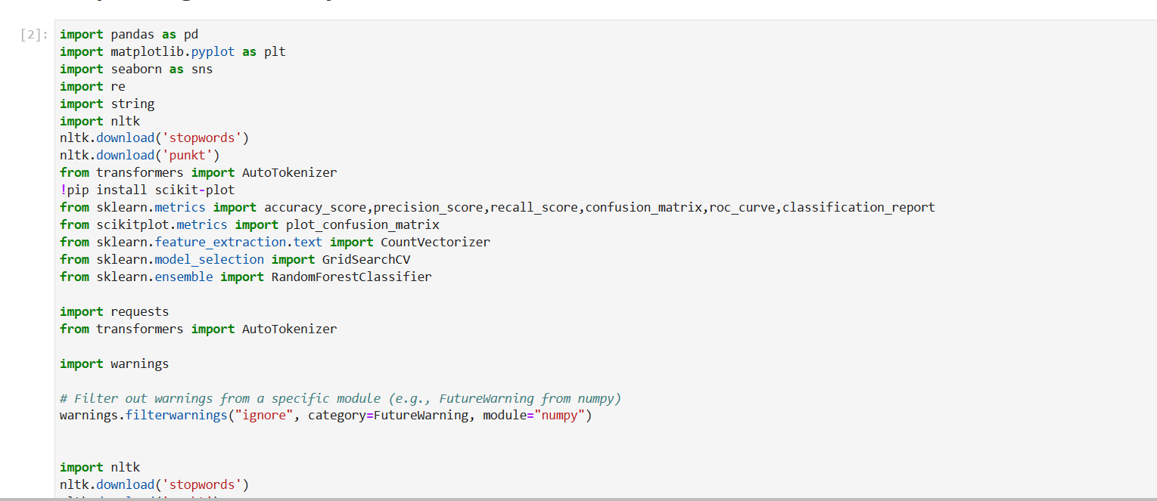
Importing Libraries

Slide 4
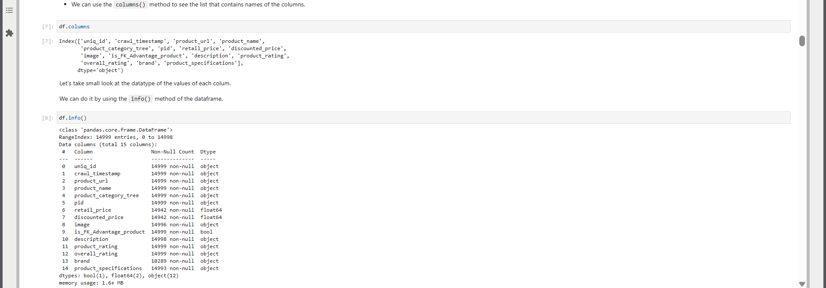
Understanding Data

Slide 5
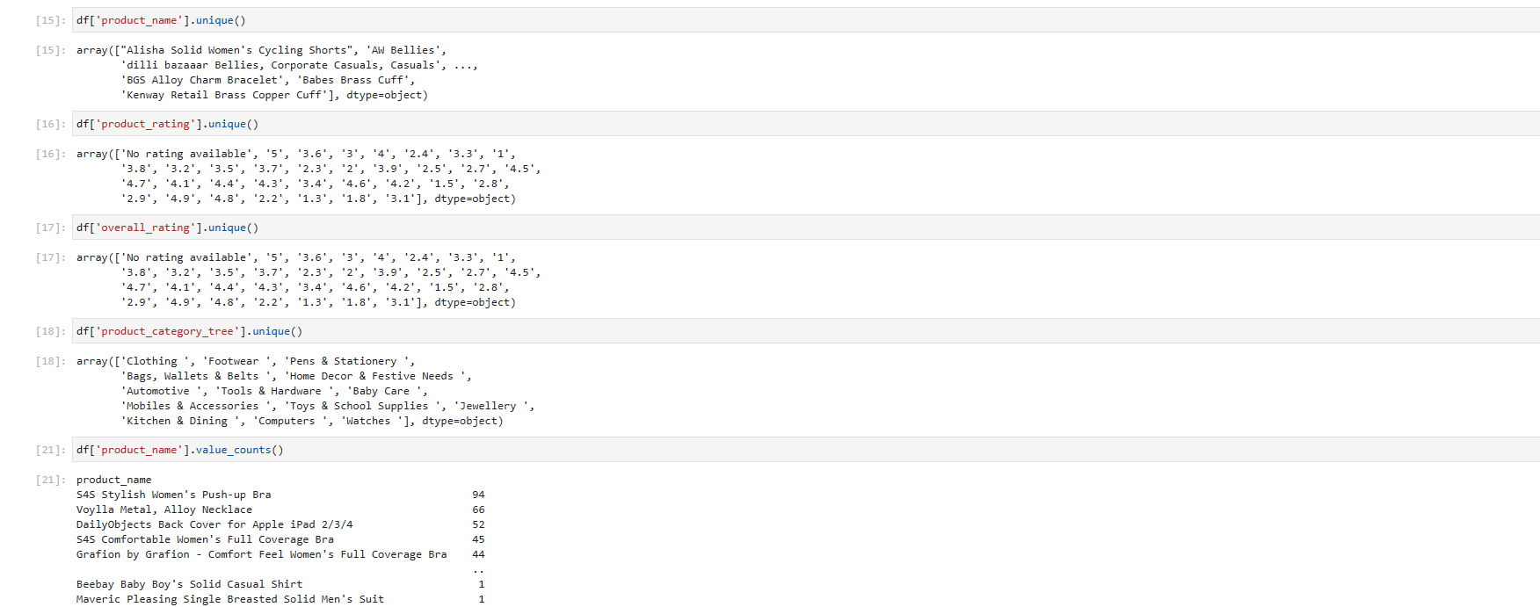
Exploratory data Analysis

Slide 6
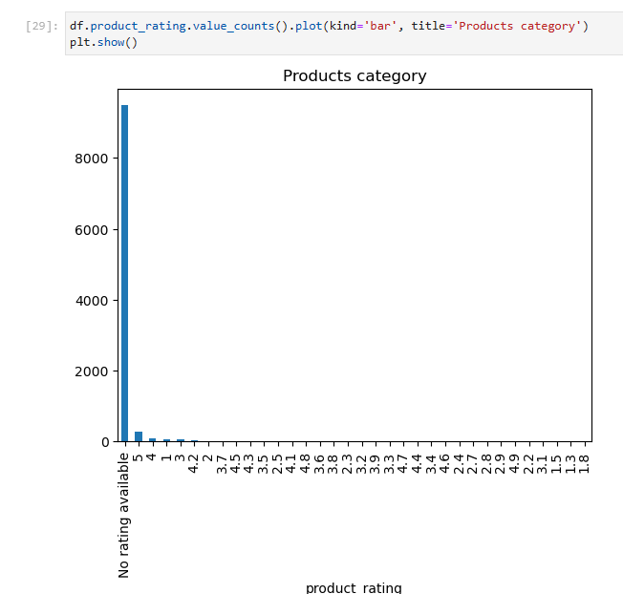
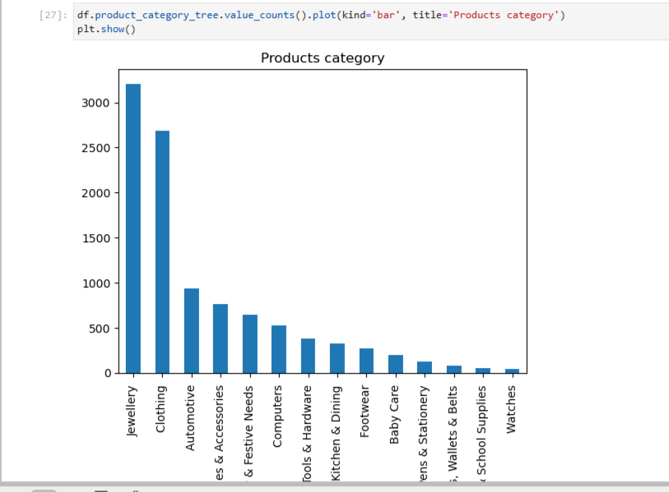
Visualisation of Data

Slide 7
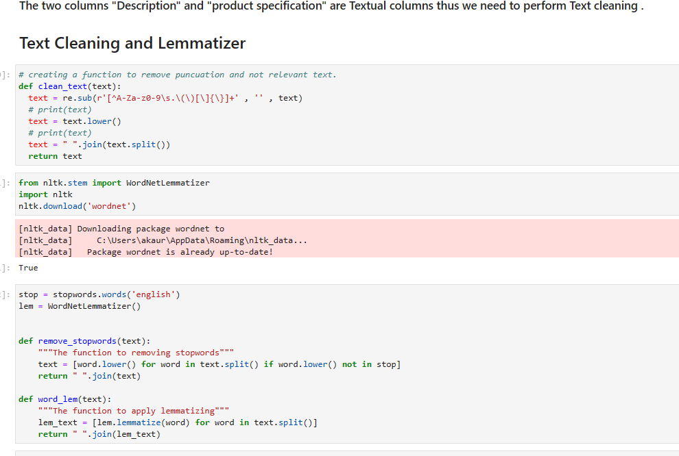
Feature Engineering
Data Cleaning with Lemmatization

Slide 8
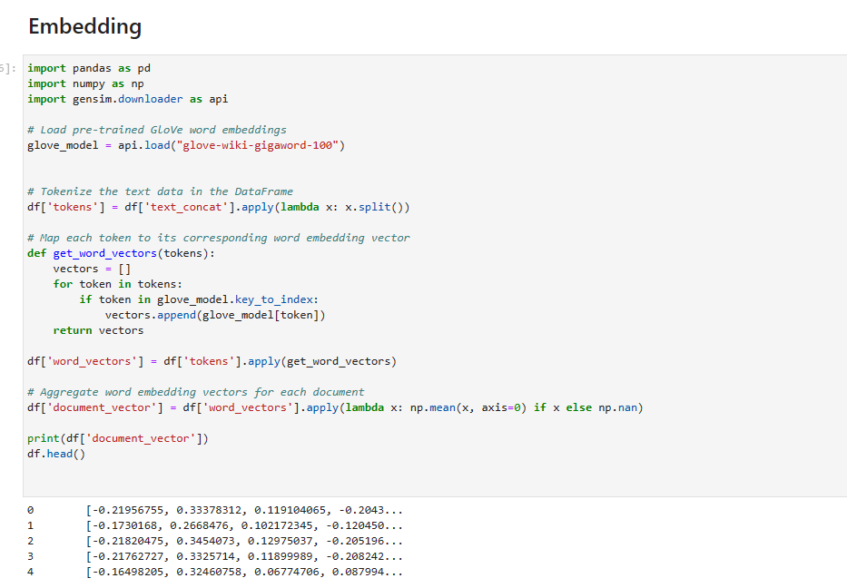
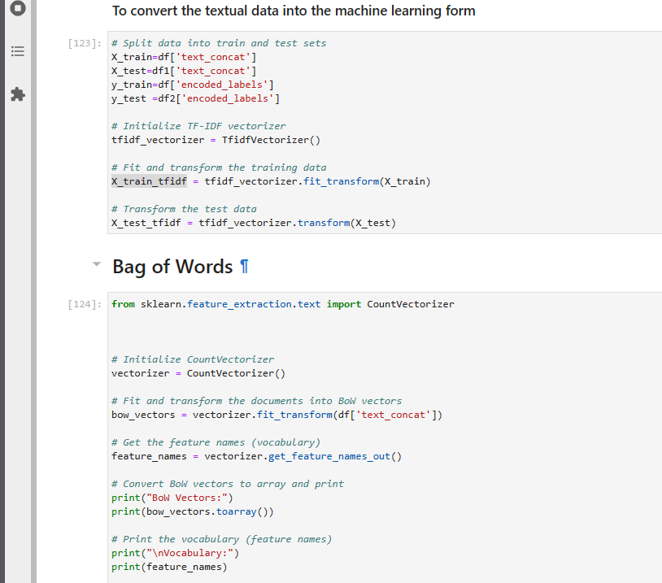
Vectorisation
To convert textual data into vector form

Slide 9
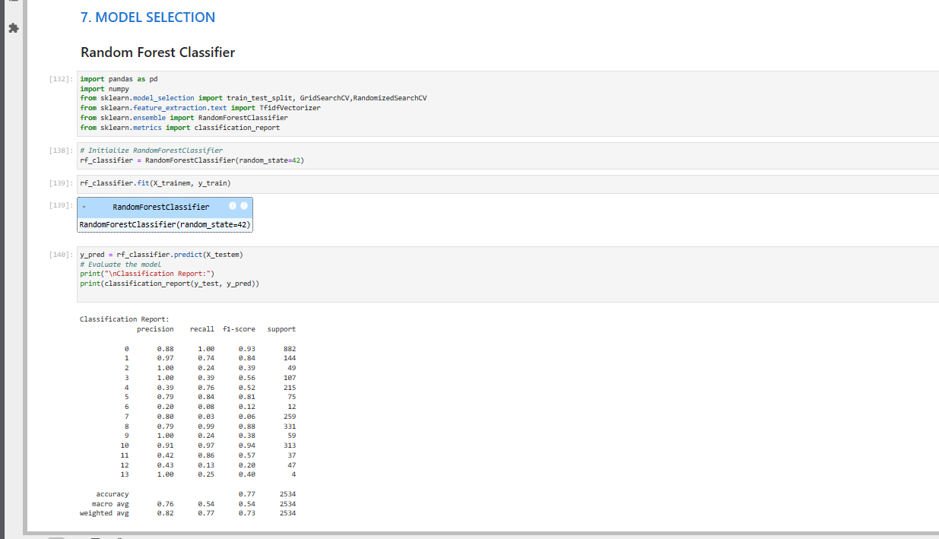
Machine learning models
Random forest classifier

Slide 10
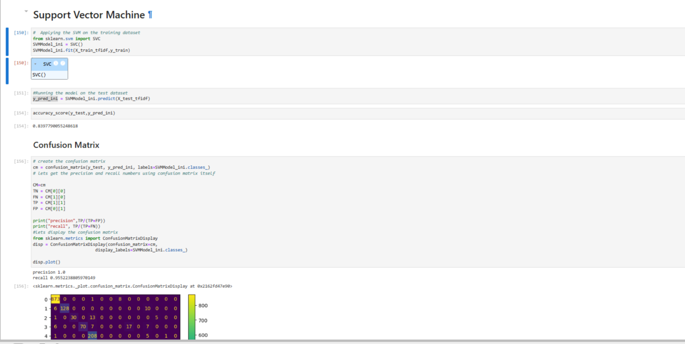
Support Vectoer Machine

Slide 11
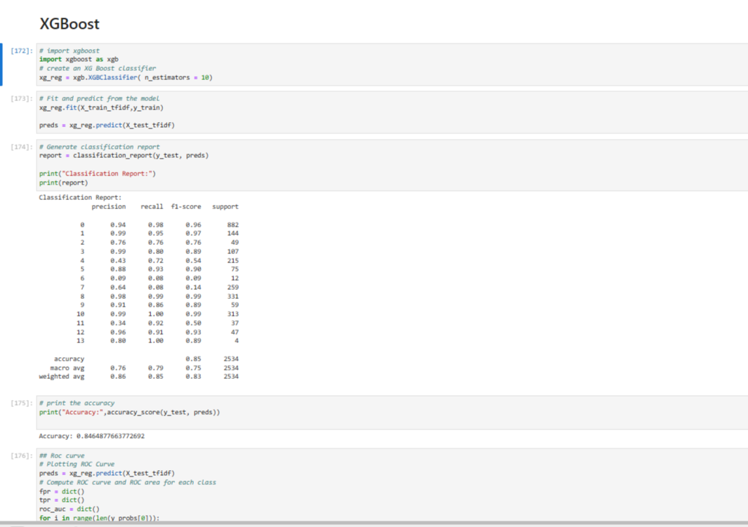
Xgboost

Slide 12
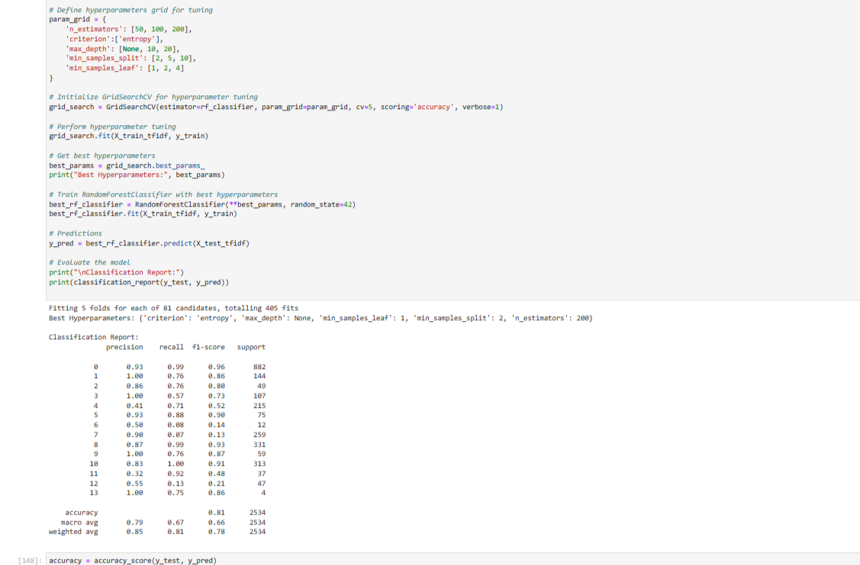
Hyperparameter Tunning

Slide 13
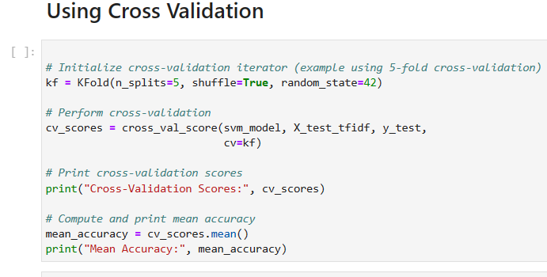
Cross validation

Slide 14
Deep learning Models
We can use other Models Like Word2vec, Bert , Doc2vec ,that uses deep learning techniques and are specially build for the Textual classification with high Accuracy.

Slide 15
Conclusion.
1. Dataset has lot of imbalance like category cloth dominate the dataset , there are 70% of product with no ratings available, etc.
2.Hyperparameter Tuning has not drastically increased the accuracy and precision of the models in the given dataset.
3. Support Vector Model has Achieved the highest Accuracy of the 84%.
4.Tf-idf vectorisation performed better than Embedding .
5. Cross validation has increase the accuracy significantly of all the models .

Slide 16
Thank you
For more Detail Do Visit the Python Notebook.

